Slide 1
Introduction to NextJs
Course Code: CSC 4182
Course Title: Advanced Programming In Web Technologies
Dept. of Computer Science
Faculty of Science and Technology
Lecture No: | 1 | Week No: | 09 | Semester:
Lecturer: | Sazzad Hossain; sazzad@aiub.edu

Slide 2
Lecture Outline
What is NextJS
NextJS Features
File-based Routing
Dynamic Routes
404 file
What is rendering?
Types of Rendering
Client-Side Rendering(CSR)
Pre-rendering
Server-side Rendering
Static Site Generation (SSG)
Static Site Generation (SSG) VS Server-Side Rendering (SSR)

Slide 3
What is NextJS
Next.js is a flexible React framework that gives you building blocks to create fast web applications.
Next.js is a React framework designed to facilitate the development of web applications
Provides building blocks and tools for creating web apps
Handles tooling and configuration needed for React
Offers additional structure, features, and optimizations

Slide 4
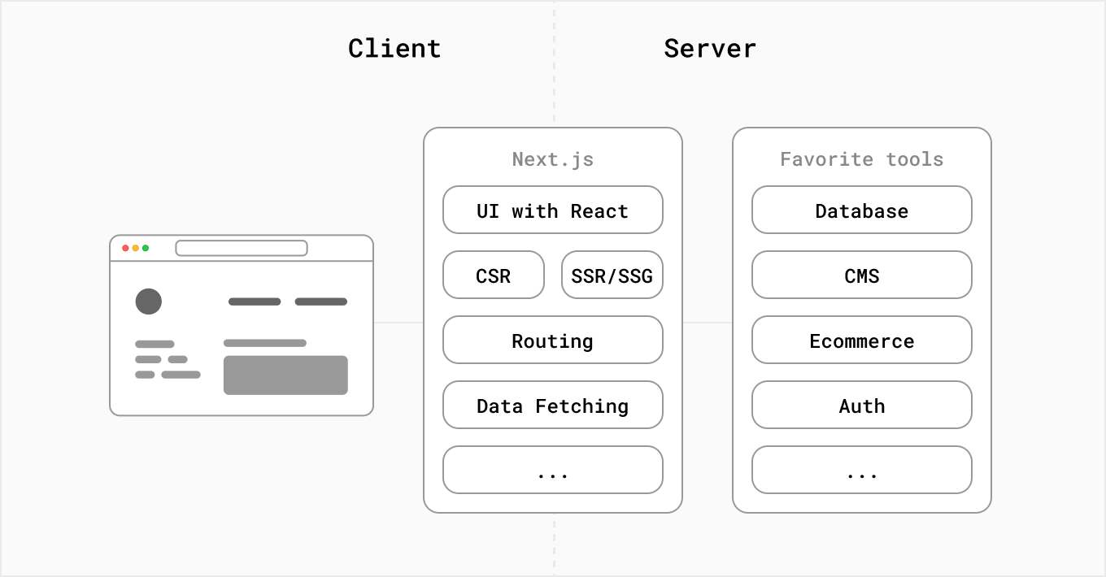
What is NextJS

Slide 5
Building Blocks of a Web Application
There are a few things you need to consider when building modern applications. Such as:
User Interface - how users will consume and interact with your application.
Routing - how users navigate between different parts of your application.
Data Fetching - where your data lives and how to get it.
Rendering - when and where you render static or dynamic content.
Integrations - what third-party services you use (CMS, auth, payments, etc) and how you connect to them.
Infrastructure - where you deploy, store, and run your application code (Serverless, CDN, Edge, etc).
Performance - how to optimize your application for end-users.
Scalability - how your application adapts as your team, data, and traffic grow.
Developer Experience - your team’s experience building and maintaining your application.

Slide 6
NextJS Features
In the development stage, Next.js optimizes for the developer and their experience building the application. It comes with features that aim to improve the Developer Experience such the TypeScript and ESLint integration, Fast Refresh, and more.
Since each environment has different considerations and goals, there is a lot that needs to be done to move an application from development to production. For instance, the application code needs to be compiled, bundled, minified, and code split.

Slide 7
NextJS Features
Folder based routing and Dynamic routing
Pre-rendering
Sever-side rendering
Static generation

Slide 8
Folder-based Routing
Follow following documents for Quiz and Project; https://nextjs.org/docs/app/getting-started/project-structure
https://nextjs.org/docs/app/getting-started/layouts-and-pages
https://nextjs.org/docs/app/getting-started/linking-and-navigating

Slide 9
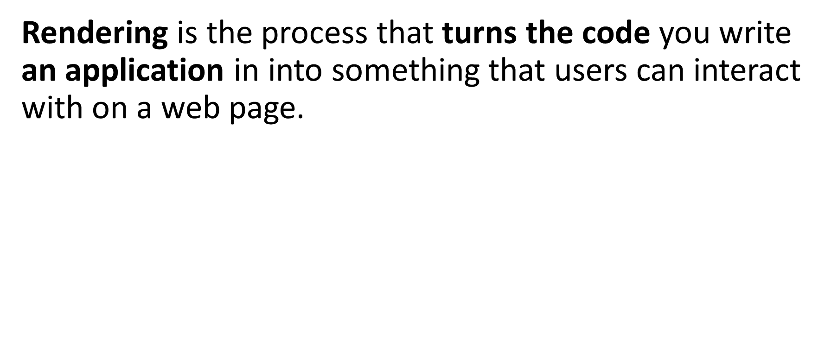
What is rendering?

Slide 10
Types of Rendering
Pre-rendering
Static Site Generation (SSG)
Server Side Rendering (SSR)
No Pre-rendering
Client-Side Rendering(CSR)

Slide 11
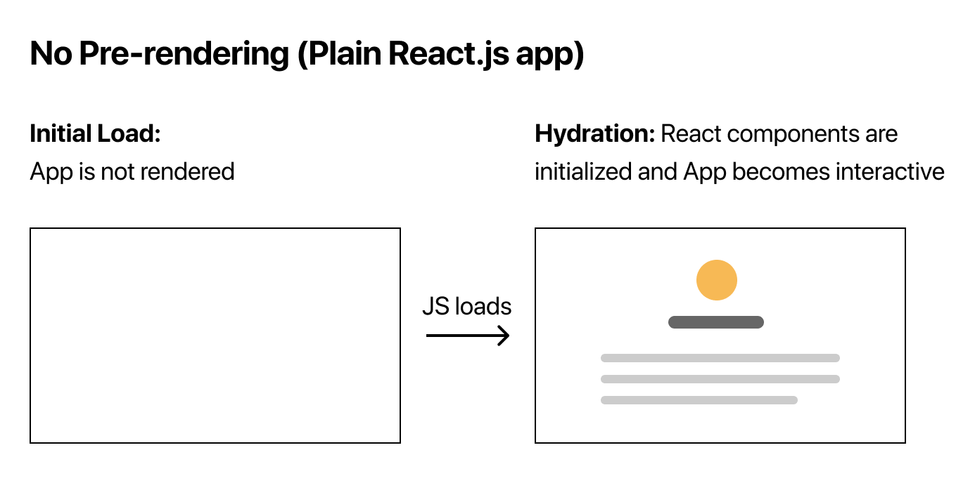
Client-Side Rendering(CSR)

Slide 12
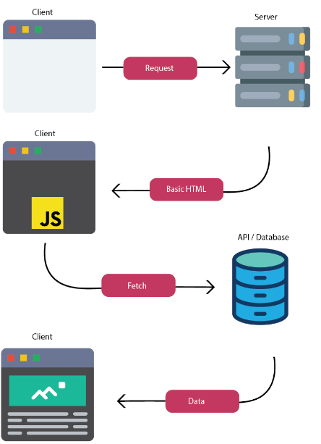
Client-Side Rendering(CSR)

Slide 13
Pre-rendering
By default, Next.js pre-renders every page.
Next.js generates HTML for each page in advance, instead of having it all done by client-side JavaScript.
Pre-rendering can result in better performance and SEO.
Each generated HTML is associated with minimal JavaScript code necessary for that page.
When a page is loaded by the browser, its JavaScript code runs and makes the page fully interactive. (This process is called hydration.)

Slide 14
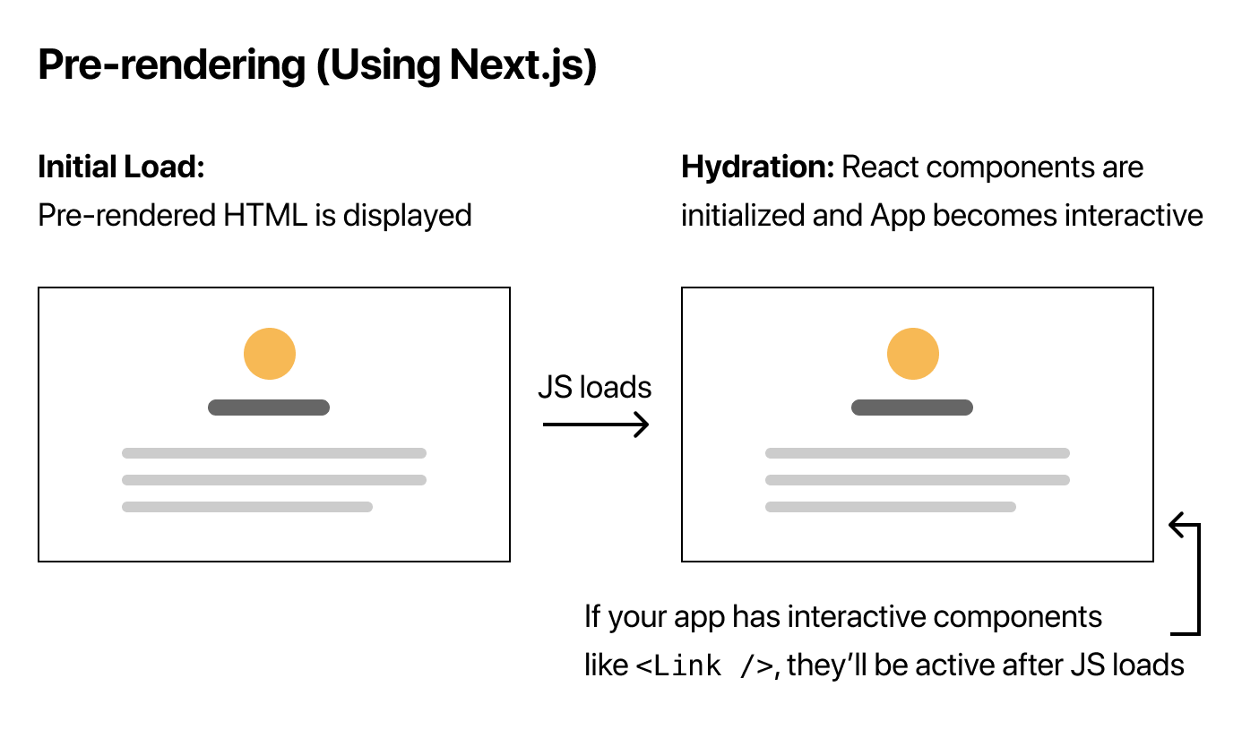
Pre-rendering

Slide 15
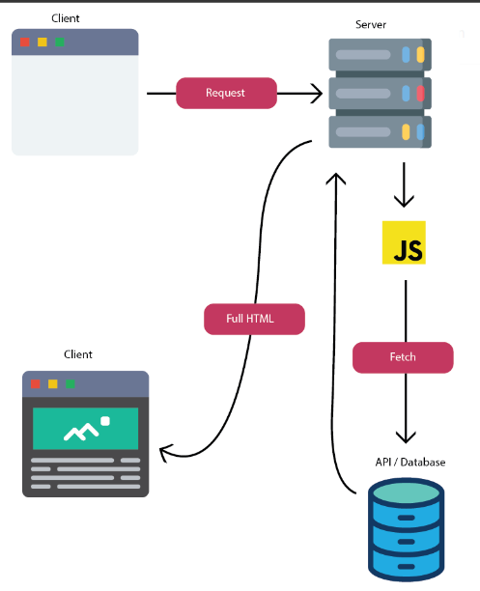
Pre-rendering

Slide 16
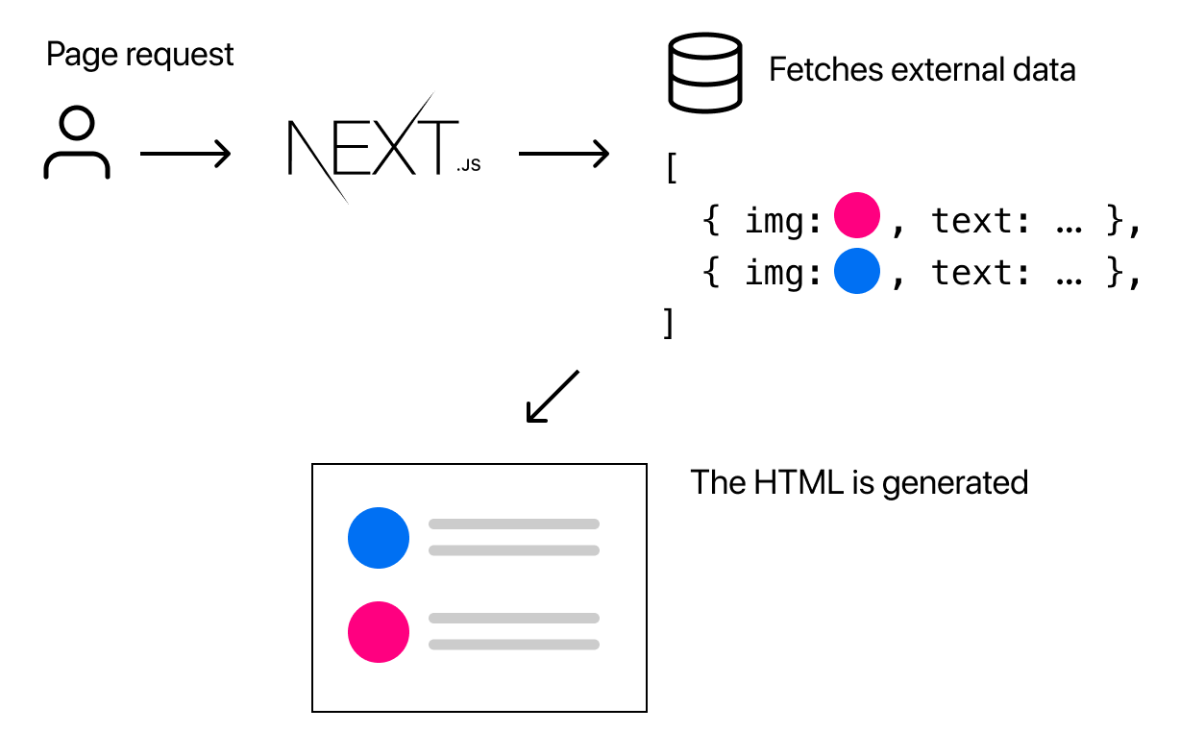
Server-side Rendering
Server-side Rendering is the pre-rendering method that generates the HTML on each request.

Slide 17
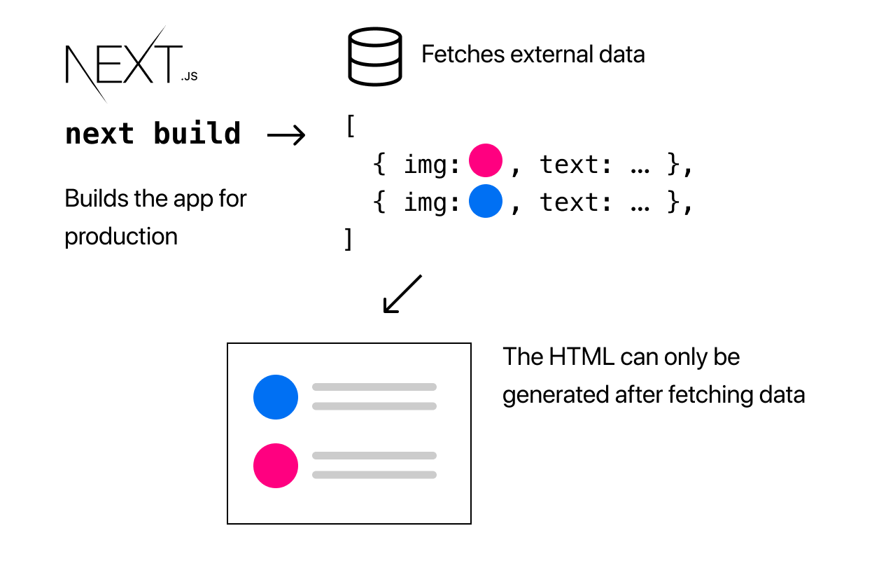
Static Site Generation (SSG)
Static Generation is the pre-rendering method that generates the HTML at build time.
The pre-rendered HTML is then reused on each request.

Slide 18
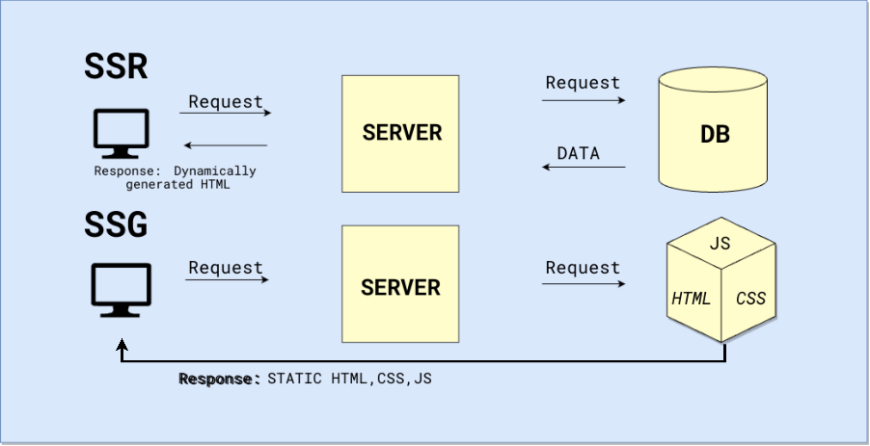
Static Site Generation (SSG) VS Server-Side Rendering (SSR)

Slide 19
References
W3Schools Online Web Tutorials, URL: http://www.w3schools.com
Next.js, URL: https://nextjs.org/
Mozilla Developer Networks, URL: https://developer.mozilla.org/

Slide 20
Thank You!

